Slide 1
REAL TIME INTRUSION DETECTION SYSTEM
Presented by
Niranjan
Devika vinod
Pavithra
Vishnu
Abhijith

Slide 2
INTRODUCTION
In the modern digital era, computer networks are more connected and complex than ever before, making them increasingly vulnerable to various cyber threats.
Traditional security solutions like firewalls and antivirus software are reactive and may fail to detect new or sophisticated attacks.
An Intrusion Detection System (IDS) provides proactive monitoring by observing traffic in real time and identifying unauthorized or malicious activities.
Our project implements an IDS, which monitors traffic across the entire network infrastructure to detect threats as they occur.

Slide 3
MOTIVATION
This project focuses on implementing a network-based Intrusion Detection System (IDS) using a combination of Cisco Packet Tracer for network simulation and Python with Scapy for packet analysis.
The simulated network consists of routers, switches, PCs, and a Syslog server, with one of the PCs designated as the target for monitoring potential attacks.
The Python-based IDS script listens to the network traffic in real time and detects different types of scanning and flooding attacks such as SYN scan, NULL scan, FIN scan and XMAS scan.
Whenever suspicious activity is detected based on traffic patterns and thresholds, the system generates alerts and stores them in a log file.
This project demonstrates how custom-built IDS solutions can effectively monitor network security, providing valuable insights into intrusion detection mechanisms while helping users learn practical concepts of cybersecurity, packet analysis, and network management.

Slide 4
CONFIGURATION
1. Network Topology Overview
The system is implemented on a simulated or physical topology with the following devices:
3 × Routers (Cisco 1941): Connect different network segments; interconnect using serial links.
2 × Switches (Cisco 2950-24): Connect end devices and enable LAN communication.
2 × PCs: Act as user endpoints; generate and receive traffic for testing IDS.
1 × Server (Syslog Server): Collects logs and alerts from the NIDS in real time.
2. Cable Requirements
Serial DCE/DTE Cables: Used for inter-router connections.
Copper Straight-Through Cables: Used for connecting:
PCs to switches
Switches to routers
Server to switch
3. Key Functions of the Setup
Router Connections: Simulate a distributed enterprise network.
Switch Layer: Handles local traffic and enables PC-to-server communication.
Syslog Server: Receives and stores alerts from the intrusion detection scripts running on the PCs.

Slide 5
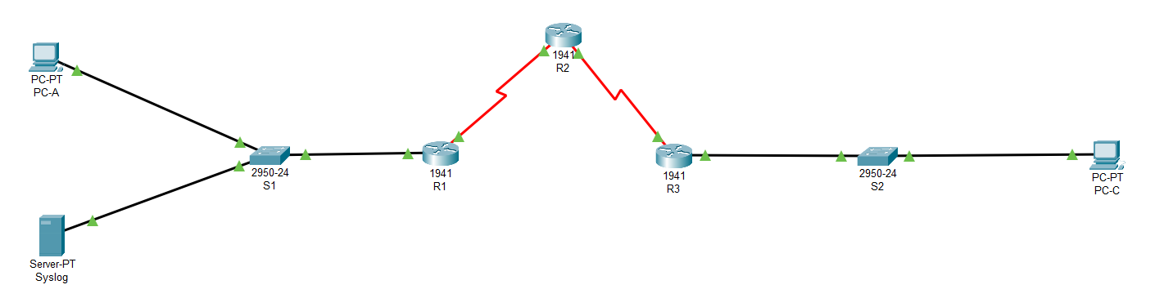
CONFIGURATION

Slide 6
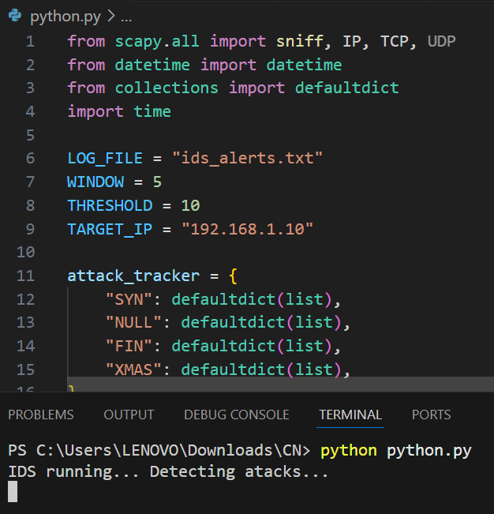
CODE
Python-Based IDS Script
Written using Scapy, a powerful packet manipulation tool.
Detects suspicious traffic patterns (e.g., SYN, NULL, FIN, XMAS scans).
Tracks attacks per IP using defaultdict for dynamic and efficient storage.
Code Explanation
LOG_FILE = "ids_alerts.txt": Alerts are stored in this log file.
WINDOW = 5: Time window (in seconds) to group suspicious packets.
THRESHOLD = 10: Number of packets to trigger an alert.
TARGET_IP = "192.168.1.10": Monitoring traffic aimed at this device.
attack_tracker: Tracks multiple attack types using time and source IP.
Live Terminal Output
Shows status: IDS running... Detecting attacks...
Confirms that real-time packet sniffing has begun.
IDS running..

Slide 7
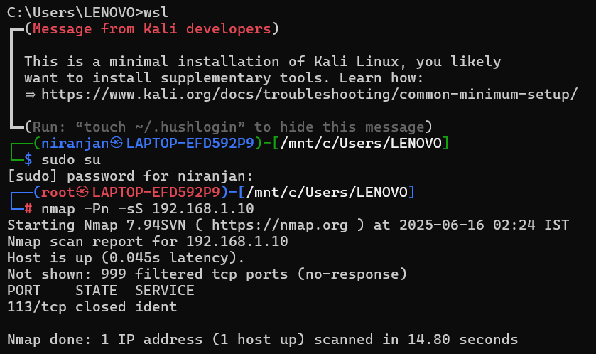
ATTACK
Purpose of the Test
To evaluate whether the IDS can correctly detect and alert on active reconnaissance.
SYN scans are commonly used by attackers to probe for open ports without completing TCP handshakes.
Attack Details
Tool Used: Nmap (via Kali Linux WSL terminal).
Command:
nmap -Pn -sS 192.168.1.10
-Pn: Skip host discovery (treat host as online).
-sS: Perform a stealthy TCP SYN scan.
Target: 192.168.1.10 (as set in the IDS script).
Result:
Host is up.
Most ports are filtered (likely due to firewall).
One closed port reported: 113/tcp closed ident.

Slide 8
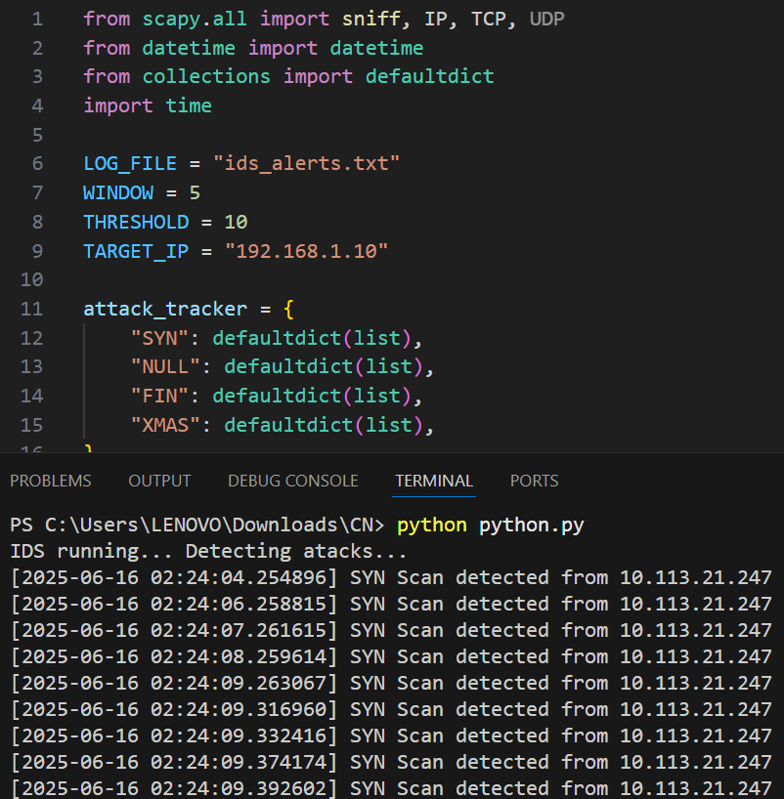
Successful Detection – IDS in Action
Detection Workflow
IDS continuously monitors traffic to 192.168.1.10.
A series of packets are detected within the defined threshold.
Alerts are timestamped and generated in real time.
Alert Output
Each detection log includes:
Timestamp
Type of scan (e.g., SYN Scan)
Source IP
Alerts are displayed on the terminal and saved in ids_alerts.txt.

Slide 9
CONCLUSION
Successfully implemented a Real Time Intrusion Detection System using Python.
Demonstrated real-time detection of network-based attacks such as SYN scans.
Utilized open-source tools and libraries (Scapy, PyShark) for packet sniffing, analysis, and alerting.
The IDS can monitor traffic live, identify threats, and generate instant alerts, fulfilling its goal of proactive security.
Simple and modular design allows it to be extended and integrated into real networks.

